Slide 1
Poisson Regression
Modeling Count Dependent Variable

Slide 2
Contents
01
02
Understanding Poisson Distribution
Poisson Regression Model
03
04
Modeling Complaint Count
Estimation of Parameters
05
06
Goodness of Fit Test
Predicted Values

Slide 3
Understanding Poisson Distribution
There are several phenomena where the variable is a 'count' of rare events observed within a specific time period, such as:
Number of deaths caused by lightning in six months
Number of insurance claims in one year
Number of website visits per hour
Number of defects in manufactured products
Such random variables do not follow Normal distribution and therefore cannot be modeled using multiple linear regression.
The probability distribution best suited for such count data is Poisson distribution, and the regression model used is Poisson regression.

Slide 4
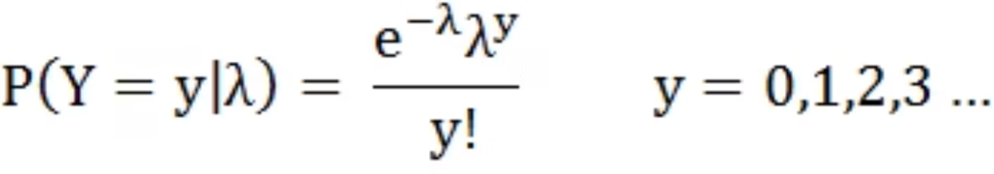

Understanding Poisson Distribution
Poisson distribution is a limiting case of Binomial distribution where:
n (Number of trials) is very large
p (Probability of success) is very small
np is finite
n → ∞
p → 0
np = λ (lambda)
In other words, the chance of success is very small and the trial is repeated a large number of times.
The Probability Mass Function is :
Key Property: For Poisson distribution, Mean = Variance = λ

Slide 5
Poisson Regression
Dependent Variable
Independent Variables
Count
Categorical or Continuous
Often it is the count of a rare event. Counts are all positive integers (0, 1, 2, 3, ...).
Can include both types of predictor variables in the same model.
Poisson regression is most suitable in the case of rare events where counts tend to be small relative to the observation period.
Poisson regression is a type of Generalized Linear Model (GLM), where the link function is a logarithm and the underlying probability distribution is Poisson.

Slide 6
Application Areas
Poisson regression finds widespread application across multiple industries and research domains where count data analysis is essential.
Industry/Function
Purpose
Model/Predict
Based on Information Such As
Insurance Analytics
Prediction
Insurance Claims
Policy holder details, risk characteristics, coverage type, demographics
Education or HR
Prediction / Optimization
Absenteeism
Student/employee demographics, institutional features, workplace culture
Clinical Research
Prediction
Adverse Events During Clinical Trial
Medicine dosage, patient history, external conditions, demographics

Slide 7
Statistical Model
log(λ) = b₀ + b₁x₁ + b₂x₂ + … + bₖxₖ
Where λ is the conditional mean of Y given X
Why Not OLS?
Link Function
Ordinary least squares (OLS) used in multiple linear regression is not appropriate as Y is discrete and the right-hand side is continuous.
log(λ) is the link function used in Poisson regression, establishing a connection between Y and the linear combination of X variables.
Non-Negativity
Estimation Method
Note that λ is greater than zero, and its log will be negative if it lies between 0 and 1.
The regression coefficients are estimated using the method of maximum likelihood.

Slide 8
Case Study: Modeling Number of Complaints
Business Context
A company recently launched a loyalty program and collected comprehensive information about their customers. The next phase aims to add 20,000 new customers to their loyalty pool.
The company needs to understand complaint patterns to set up a call center with optimal staffing strength. This predictive modeling will enable efficient resource allocation and improved customer service planning.
Research Objective
Available Data Variables
To model the number of complaints in order to prepare a strategic roadmap for call center operations in the next phase of the loyalty program.
Region (geographic location)
Loyalty Tier (platinum, gold, silver)
Customer's Association with Company (tenure)
Number of Complaints (outcome variable)
Study Parameters
Sample size: 113 customers
Target expansion: 20,000 new customers
Focus: Call center capacity planning

Slide 9
Case Study: Data Snapshot
Below is a sample of the customer dataset used for modeling. Each row represents a unique customer with
their characteristics and complaint count.
custid
region
tier
age
ncomp
1
N
platinum
less2
0
2
W
gold
more2
3
3
W
silver
less2
9
4
S
silver
less2
6
5
E
silver
less2
7
6
N
silver
less2
5
7
N
gold
less2
4
8
N
gold
less2
8
Note: The complete dataset contains 113 customer records with varying complaint counts across different regions,
loyalty tiers, and tenure categories.

Slide 10
Data Structure
The dataset comprises customer records with complaint counts as the dependent variable. Each observation represents a unique customer identified by their customer ID, with associated characteristics that may influence complaint behavior.
Variable Overview
Data Characteristics
Variable
Description
Dependent Variable: Number of complaints (ncomp)
custid
Customer ID (unique identifier)
Independent Variables: Region, loyalty tier, and customer age
region
Geographic region (E, W, N, S)
Sample Size: 113 observations across diverse customer segments
tier
Loyalty program level (platinum, gold, silver)
age
Customer tenure (less2, more2)
ncomp
Complaint count (dependent variable)

Slide 11

Model Specification and Base Categories
In categorical regression analysis, one category from each independent variable must serve as the reference or base category. The coefficients for other categories represent the effect relative to this baseline, enabling meaningful interpretation of results.
Region Variable
Tier Variable
Age Variable
Categories: East (E), West (W), North (N), South (S)
Categories: Platinum, Gold, Silver
Categories: less2, more2
Base Category: Gold
Base Category: less2
Base Category: East (E)
Platinum and Silver coefficients show complaint patterns relative to Gold tier customers.
The more2 coefficient indicates how longer-tenure customers differ from newer ones.
Coefficients for W, N, and S represent differences from the East region baseline.
Important: Base categories are excluded from the model to avoid multicollinearity. Their effect is captured in the intercept term, while other categories show relative differences.

Slide 12
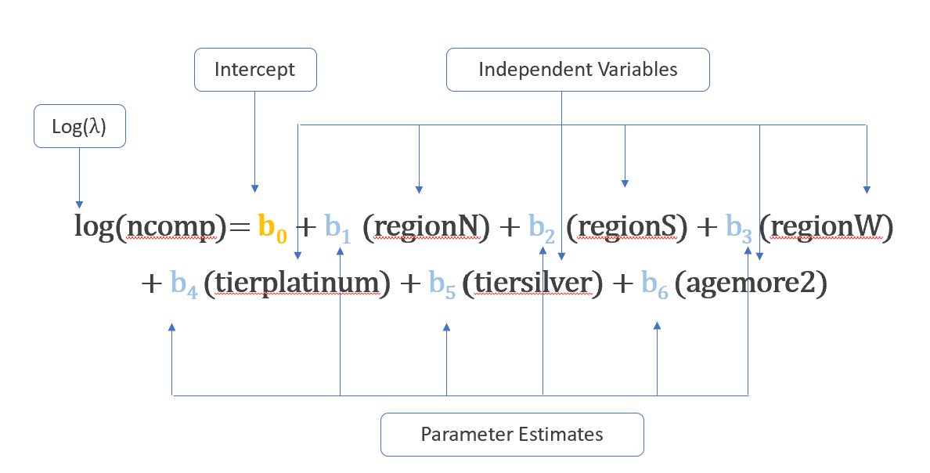
Model for the Case Study
The Poisson regression model is :

Slide 13

Estimation of Parameters
Model Output
The following table presents the estimated coefficients, standard errors, z-values, and p-values for each predictor in the Poisson regression model.
Variable
Estimate
Std. Error
z value
Pr(>|z|)
(Intercept)
1.7918
0.1079
16.603
< 2e-16 ***
regionN
-0.2513
0.1334
-1.884
0.0596
regionS
-0.1093
0.1263
-0.865
0.3870
regionW
-0.0513
0.1386
-0.370
0.7114
tierplatinum
-0.8283
0.1729
-4.791
1.66e-06 ***
tiersilver
0.0669
0.1067
0.627
0.5305
agemore2
-0.3301
0.0984
-3.354
0.0008 ***
Interpretation: The Estimate column provides the estimated coefficients of the independent variables in the model. These represent the change in log-expected count for a one-unit change in the predictor, holding other variables constant.
*** indicates statistical significance at p < 0.001 level. Platinum tier and tenure (agemore2) show significant effects on
complaint counts.

Slide 14
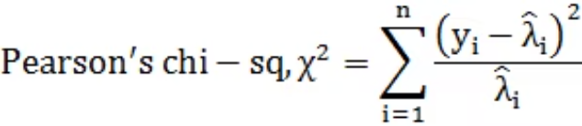
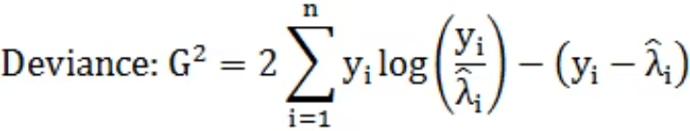

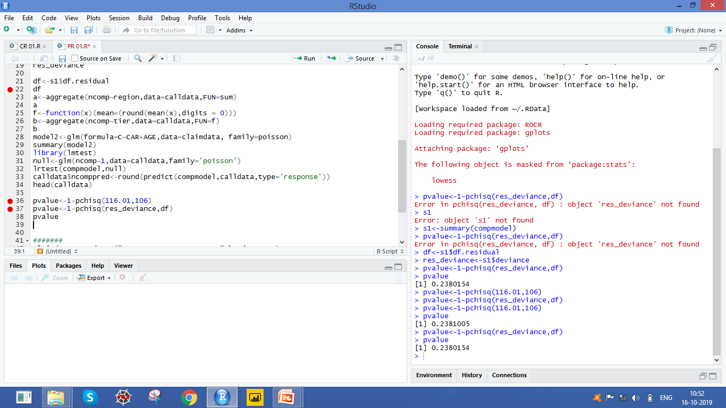
Goodness of Fit : Testing Model Adequacy
Objective
Decision Criteria
To test the null hypothesis that the model is a good fit to the
observed data.
Reject the null hypothesis if p-value < 0.05
Null Hypothesis (H₀): Model is a good fit
Alternate Hypothesis (H₁): There is significant lack of fit
Test Statistic 1: Residual Deviance
Test Statistic 2: Pearson Chi-Square
Interpretation: Since p-value > 0.05, we do not reject H₀. The model can be considered to be a good fit to the data, indicating that it adequately captures the relationship between predictors and complaint counts.

Slide 15

Predictions in Poisson Regression
The fitted Poisson regression model generates predicted complaint counts for each customer based on their characteristics. Below is a comparison of observed versus predicted values.
Model Predictions
Customer ID
Region
Tier
Age
Observed (ncomp)
Predicted
1
N
platinum
less2
0
1.84
2
W
gold
more2
3
4.21
3
W
silver
less2
9
6.39
4
S
silver
less2
6
5.67
5
E
silver
less2
7
6.42
6
N
silver
less2
5
4.98
Interpretation: The last two columns show observed and predicted values of "ncomp" (number of complaints). The model provides reasonable predictions that can be used for capacity planning and resource allocation in the call center.
These predictions enable the company to estimate expected complaint volumes for the 20,000 new customers in the next phase of the loyalty program.

Slide 16
Introduction to Zero-Inflated Poisson Regression
One common cause of over-dispersion is excess zeros, which in turn are generated by an additional data generating process. In this situation, zero-inflated poisson regression should be considered
Zero-inflated models attempt to account for excess zeros. In other words, two kinds of zeros are thought to exist in the data, "true zeros" and "excess zeros". Zero-inflated models estimate two equations simultaneously, one for the count model and one for the excess zeros.

Slide 17
Offset Variable in Poisson Regression
Poisson regression can be used to analyze not only count data but also rate data.
01
02
03
Understanding Rates
Defining the Offset
Model Implementation
Rates are simply counts divided by a measure like total count or time. For example, insurance claim rate is measured as the number of claims divided by the total number of policyholders (say N).
The log-transformed regression variable with a constant coefficient of 1 for each observation is known as the 'Offset'.
The Poisson model is fit to the counts and uses the log of the denominator (usually N) as an offset variable, allowing proper modeling of rates rather than raw counts.
Using an offset allows the model to account for different exposure times or population sizes across observations, making rate comparisons meaningful and statistically valid.

Slide 18




Key Takeaways
Poisson Distribution
Poisson Regression
Limiting case of Binomial Distribution-large n and small
p
The model for Count Variable for rare events
Method of Estimation
Offset Variable
MLE is used to estimate the parameters of the model
To account for different exposure times or population sizes across observations

